Slide 1
Introduction to Emergency Evacuation Wayfinding
7th Triennial International Aircraft Fire and Cabin Safety Research Conference
Cynthia L. Corbett
December 3, 2013

Slide 2
Introduction to Wayfinding
Encompasses all aspects of human travel
Layout of environmental routes
Paths
Roadways
Hallways and Corridors
Aisles, Passageways and Egress Routes
Enhanced by signs, symbols and signals
Roadway Markers
Directional Signs
Exit Locators
Behaviorally, actions related to identifying significant indicators related to getting from one place to another

Slide 3
Wayfinding
The dynamic interaction of humans and technology that demands an ever-growing array of information and presentation technology to yield a safe and successful.
In transport aviation, related to emergency evacuation…

Slide 4
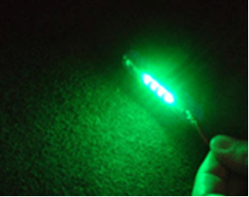
Wayfinding Technology
Visual Systems
Interior Emergency Lighting
Floor Proximity Escape Path Marking
Incandescent lamps and LEDs
Directional indicators
Electroluminescence
Photoluminescence

Slide 5
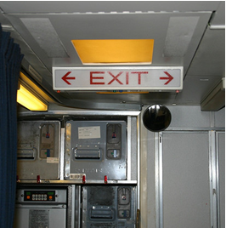
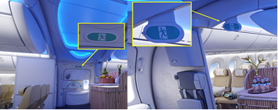
Interior Emergency Exit Marking and Locating Signs

Slide 6
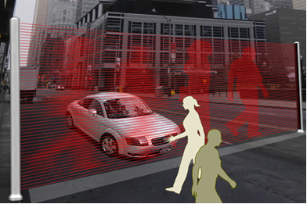
Light Amplification by Stimulated Emission of Radiation (LASER) Technology

Slide 7
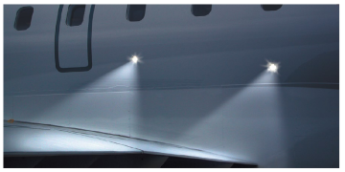
Exterior Emergency Lighting

Slide 8
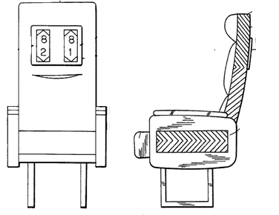
Auditory Systems
Directional sound signals/voice messages
Spoken messages
Tactile Systems
Braille
Tactiovisual systems

Slide 9
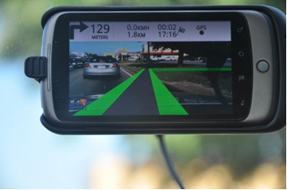
Electronic Information Technology
Virtual Environments
Simulation
Modeling
Augmented Reality
Navigation
Persuasive Technology
Change attitude
Modify Behavior

Slide 10
Symbolic Exit Signs
Comprehension of Briefing Card Elements
Computer-based Evacuation Aids
Pre-flight Safety Announcement and Humor
Learning Cabin Safety Through Play
Computer Simulations
Crew Redirection
Emergency Evacuation
Evacuation Certification
Injured Passengers
Intercrew Relations
Emergency Equipment

